Slide 1
Hulbert Financial Digest
http://www.marketwatch.com/premium-newsletters/hulbert-financial-digest
Paul A. Strassmann, Investment Club, October 6, 2014

Slide 2
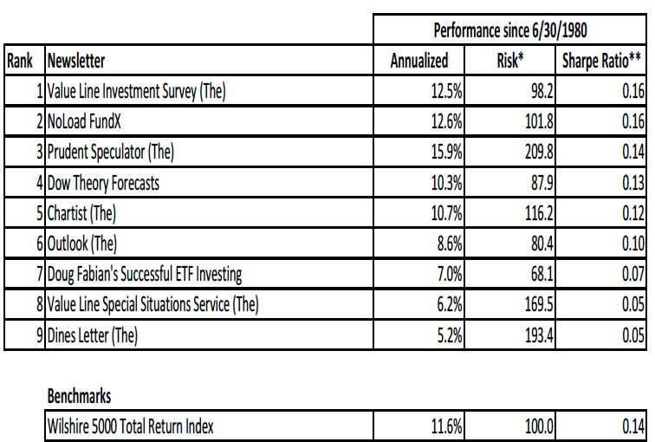
Presentation Template - 1

Slide 3
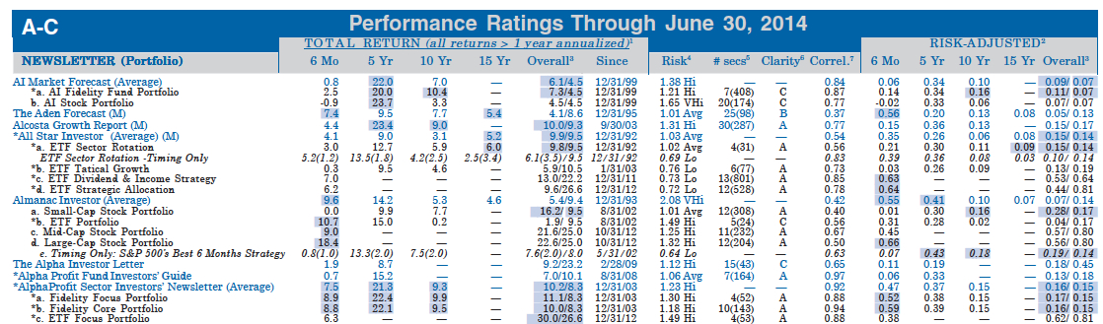
Hulbert Long Term Performance Ratings for >250 Newsletters

Slide 4
Shiller CAPE Ratio Analysis
file:///G%20Files/Investment%20Club/CAPE%20Ratio/CAPE%20Ratio%20Shiller%20Calculator.html
No Fee
Paul A. Strassmann, Investment Club, October 6, 2014

Slide 5
About the CAPE Ratio
The CAPE Ratio or the Cyclically Adjusted Profit Earnings Ratio
CAPE = Shiller Ratio,​ by 2013 Nobel Prize winner Dr. Robert Shiller.

Slide 6
Shiller Analysis
Shiller analyzed the S&P 500 Index from 1871 to the current day to determine if the CAPE a would be effective and more accurate in determining if the market as a whole was overvalued or undervalued.

Slide 7
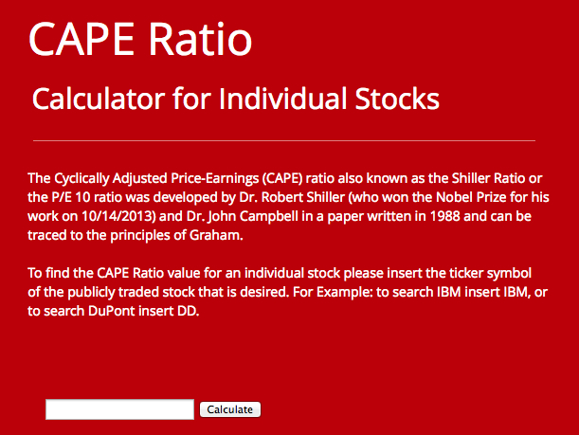
Source: http://www.caperatio.com/

Slide 8
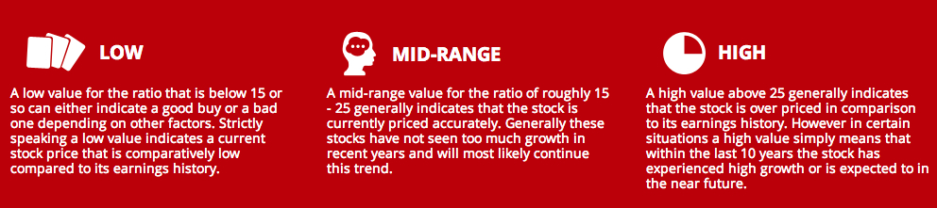
Applicability of Ranges of CAPE
http://papers.ssrn.com/sol3/papers.cfm?abstract_id=2329948
“On the Performance of Cyclically Adjusted Valuation Measures”

Slide 9
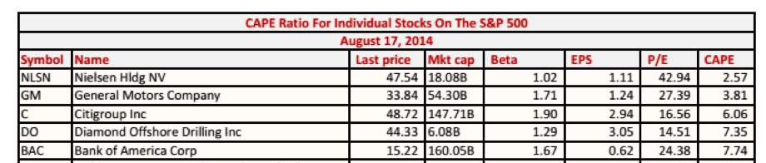
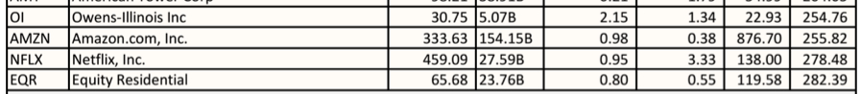
Underpriced and Underpriced Stock Valuations

Slide 10
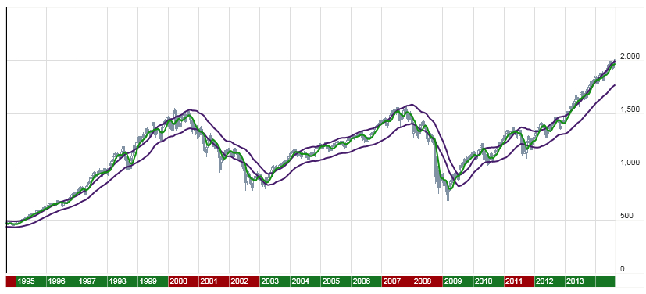
Recent History of S&P 500 Index : 1995-2014

Slide 11
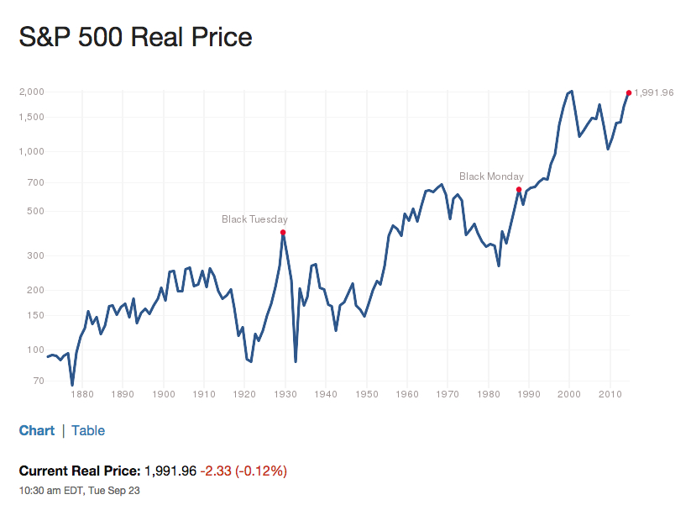

Slide 12
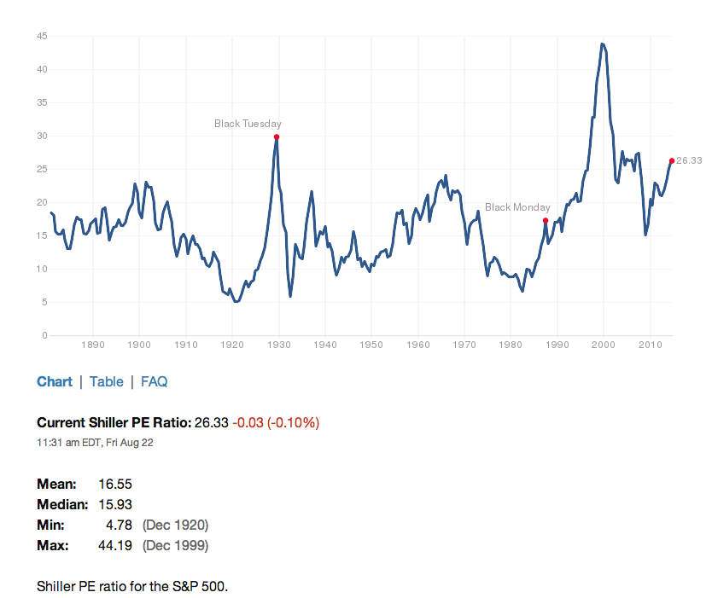
Presentation Template - 1
Historical CAPE Ratio Values

Slide 13
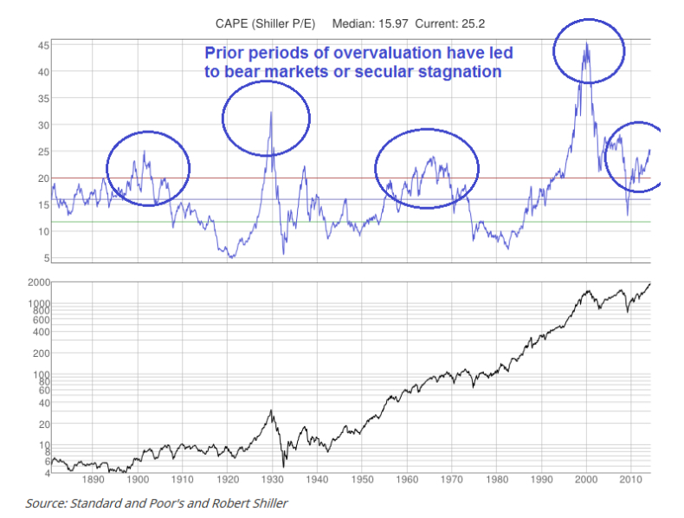

Slide 14
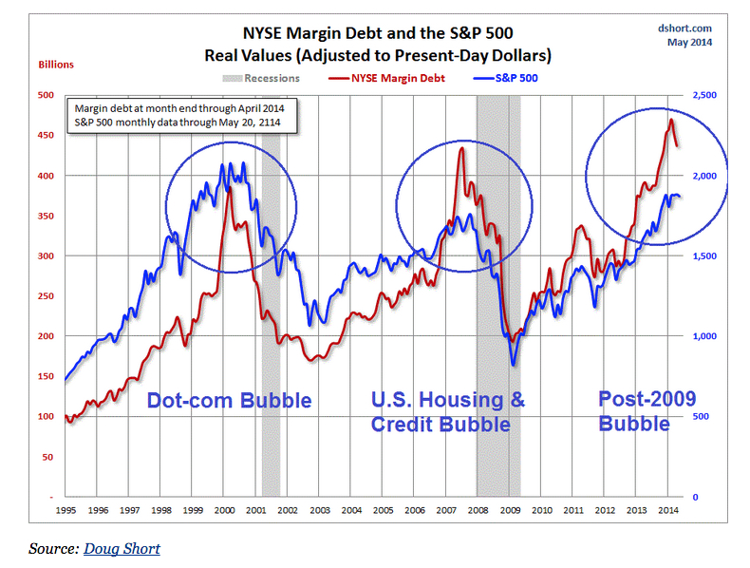

Slide 15
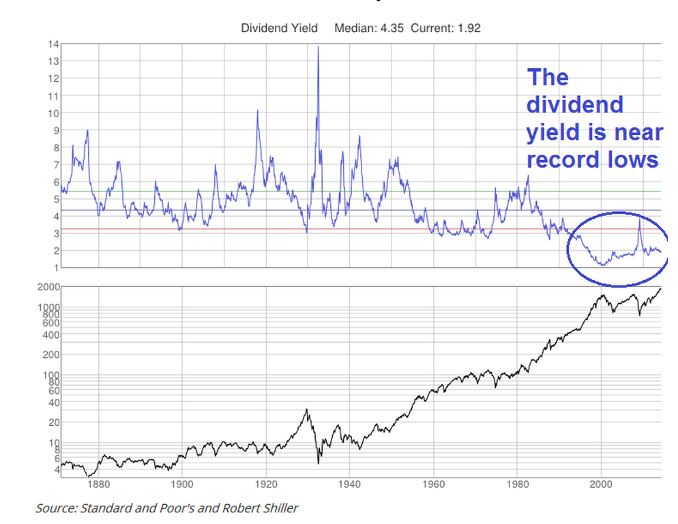

Slide 16
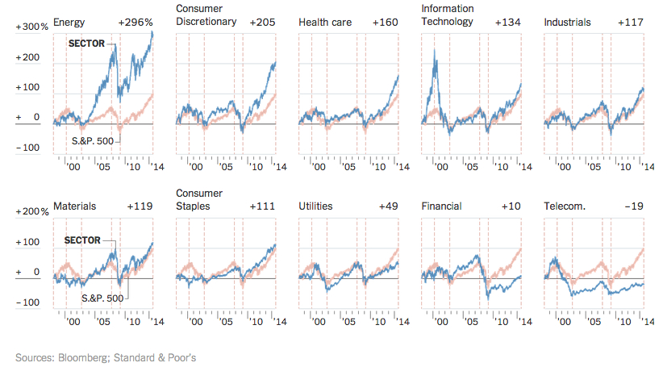

Slide 17
Berkshire Hathaway Portfolio, CAPE Ratios and Prices
 | % of Portfolio | CAPE | Current Price
American Express | 13% | $23.30 | $87.64
Coca Cola | 18% | $24.40 | $41.46
IBM | 15% | $20.40 | $191.28
Wells Fargo | 21% | $17.41 | $51.70
All Other Holdings | 33%
 | 100%

Slide 18
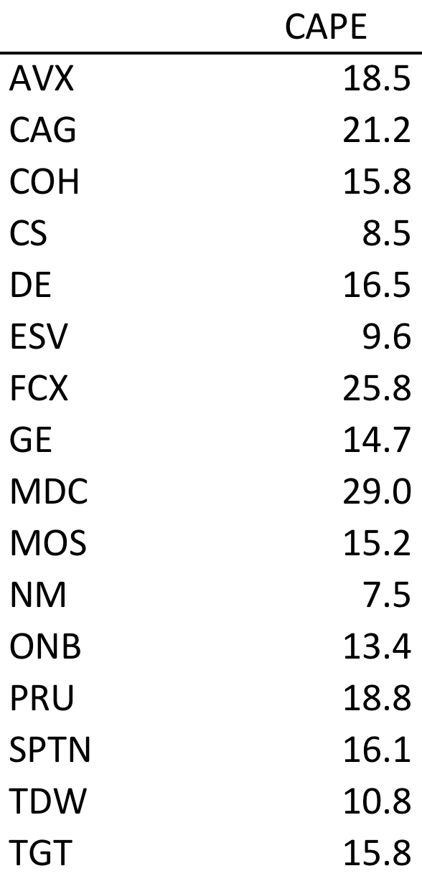
Strassmann Actual Portfolio

Slide 19
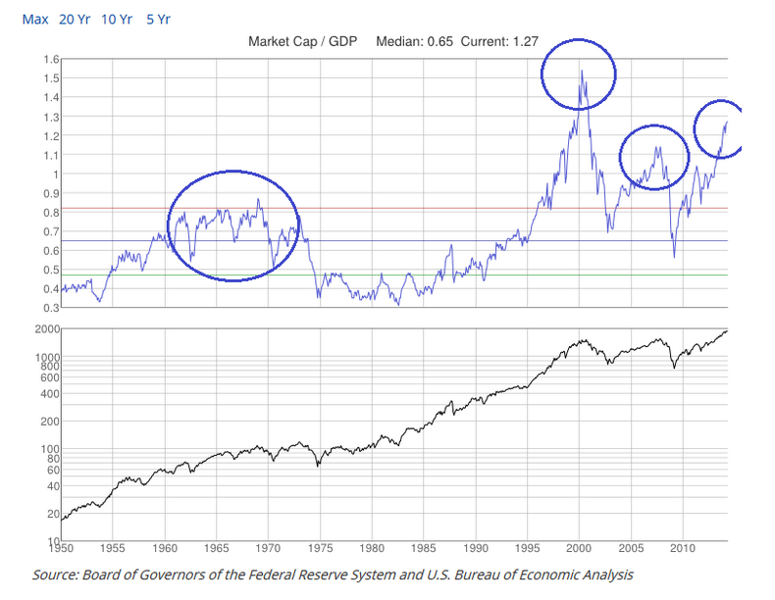

Slide 20
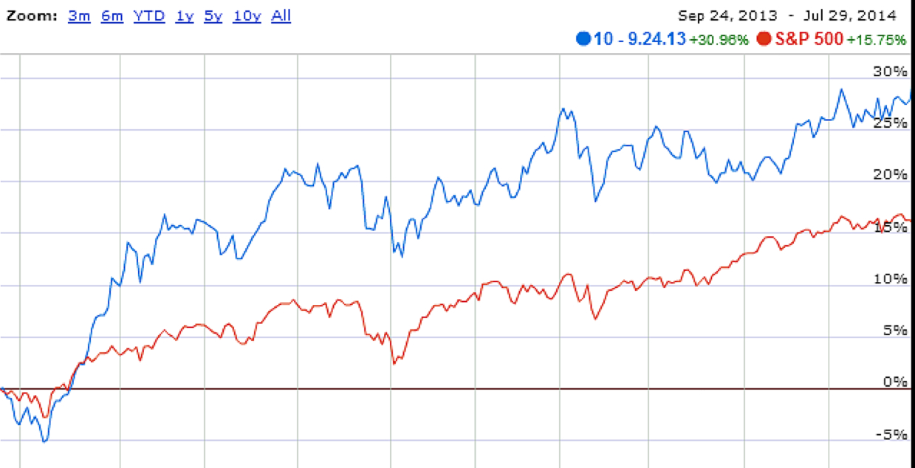
Bottom Ranked CAPE Perform Better

Slide 21
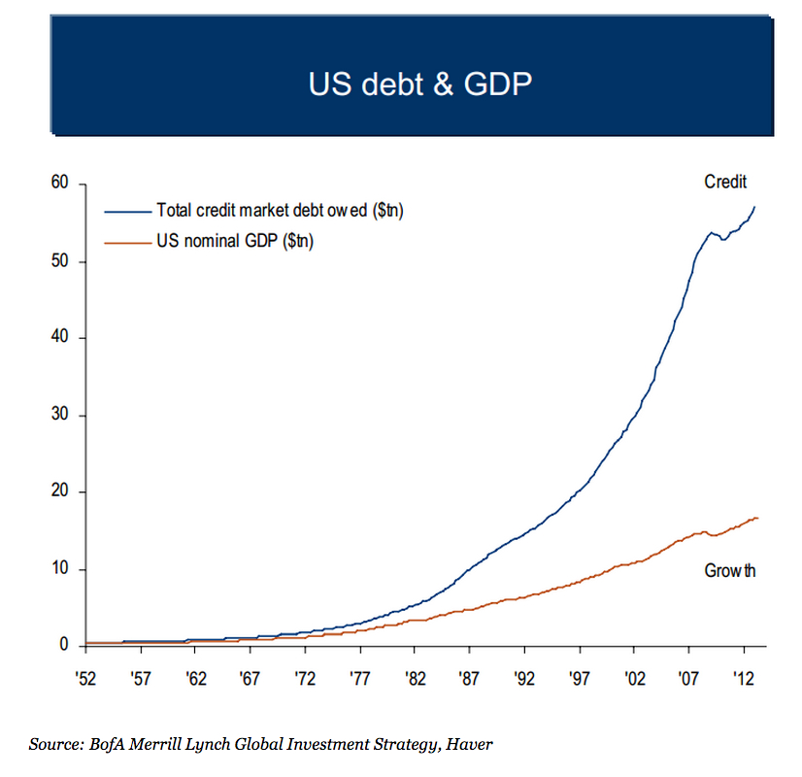

Slide 22
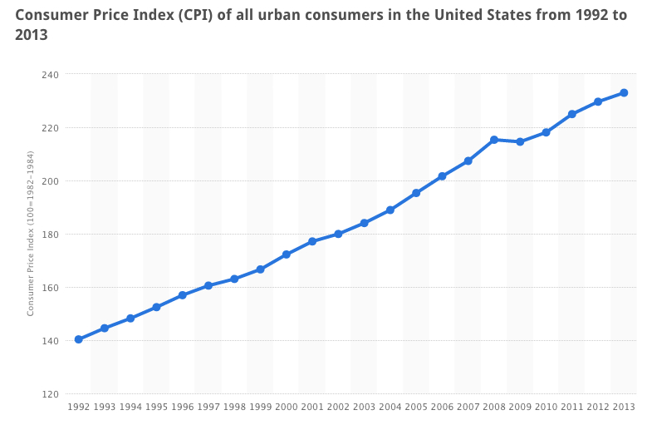
1992 – 2013 Increase in Price Index = 66% Increase in GDP = 69%

Slide 23
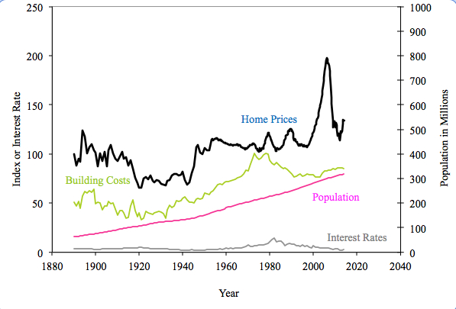
Shiller Home Prices Index

Slide 24
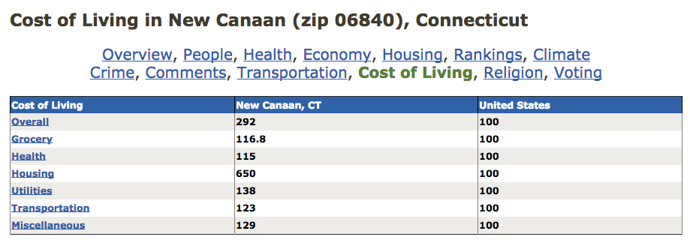
http://www.bestplaces.net/cost_of_living/zip-code/connecticut/new_canaan/06840

Slide 25
Summary
CAPE should be used as benchmark for investments
Market is getting ready for a major correction
Only selective long term investments for retirement
Housing is overpriced and ready for correction
Investment Club will track prudent investment methods

